Slide 1
File
Input/Output

Slide 2
Text Files and Binary Files
Files that are designed to be read by human beings, and that can be read or written with an editor are called text files
Text files can also be called ASCII files because the data they contain uses an ASCII encoding scheme
An advantage of text files is that the are usually the same on all computers, so that they can move from one computer to another

Slide 3
Text Files and Binary Files
Files that are designed to be read by programs and that consist of a sequence of binary digits are called binary files
Binary files are designed to be read on the same type of computer and with the same programming language as the computer that created the file
An advantage of binary files is that they are more efficient to process than text files
Unlike most binary files, Java binary files have the advantage of being platform independent also
For this course, we will deal only with text files

Slide 4
Streams
Java programs perform I/O through streams.
A stream is an abstraction that either produces or consumes information.
A stream is linked to a physical device by the Java I/O system.
All streams behave in the same manner, even if the actual physical devices to which they are linked differ.
A stream is an object that enables the flow of data between a program and some I/O device or file
If the data flows into a program, then the stream is called an input stream
If the data flows out of a program, then the stream is called an output stream

Slide 5
Byte Streams and Character Streams
Byte streams provide a convenient means for handling input and output of bytes. Byte streams are used, for example, when reading or writing binary data.
Character streams provide a convenient means for handling input and output of characters. They use Unicode and, therefore, can be internationalized. Also, in some cases, character streams are more efficient than byte streams.

Slide 6
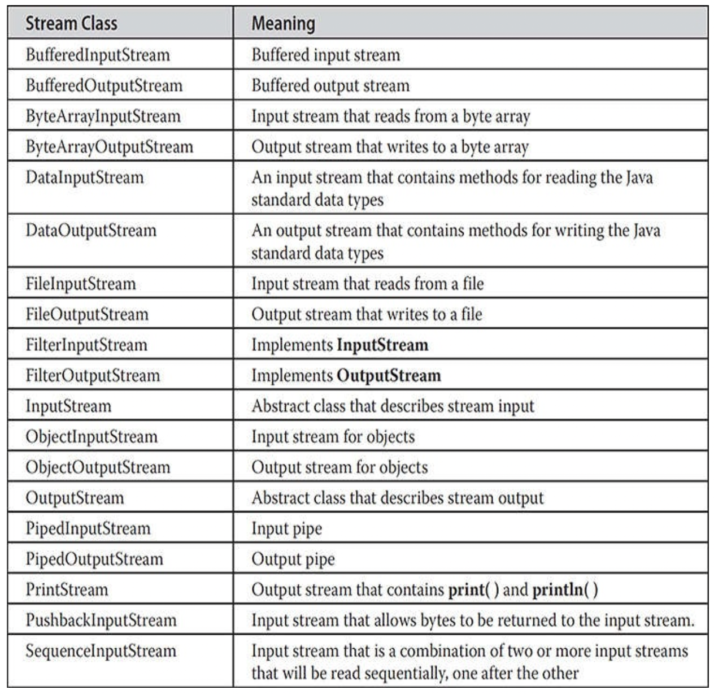
Byte Stream classes
The byte stream classes in java.io
abstract classes: InputStream and OutputStream.

Slide 7
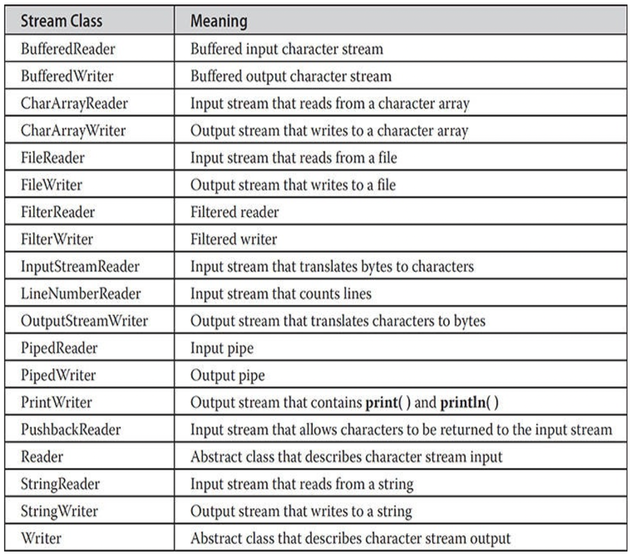
Character Stream Classes
abstract classes: Reader and Writer
character stream classes in java.io

Slide 8
Predefined Streams
Java programs automatically import the java.lang package
This package defines a class called System
System also contains three predefined stream variables
in, out, and err
public static final InputStream in
System.in is an object of type InputStream

Slide 9

Reading Console Input
Console input is accomplished by reading from System.in.
To obtain a character-based stream that is attached to the console, wrap System.in in a BufferedReader object.
BufferedReader(Reader inputReader)
InputStreamReader(InputStream inputStream)

Slide 10
Reading characters and strings
To read a character from a BufferedReader, use read( ).
int read( ) throws IOException
To read a string from the keyboard, use the version of readLine( ) that is a member of the BufferedReader class.
String readLine( ) throws IOException

Slide 11
Writing Console Output
print( ) and println( ) defined by the class PrintStream
which is the type of object referenced by System.out
System .out is a byte stream
it also implements the low-level method write( ).
void write(int byteval)

Slide 12
PrintWriter
PrintWriter is one of the character-based classes. Using a character-based class for console output makes internationalizing your program easier.
PrintWriter(OutputStream outputStream, boolean flushingOn)
PrintWriter supports the print( ) and println( ) methods
If an argument is not a simple type, the PrintWriter methods call the object’s toString( ) method and then display the result.
PrintWriter pw = new PrintWriter(System.out, true);

Slide 13
Streams
Input streams can flow from the keyboard or from a file
System.in is an input stream that connects to the keyboard
Output streams can flow to a screen or to a file
System.out is an output stream that connects to the screen
Scanner keyboard = new Scanner(System.in);
System.out.println("Output stream");

Slide 14
System.in, System.out, and System.err
The standard streams System.in, System.out, and System.err are automatically available to every Java program
System.out is used for normal screen output
System.err is used to output error messages to the screen
The System class provides three methods (setIn, setOut, and setErr) for redirecting these standard streams:
public static void setIn(InputStream inStream)
public static void setOut(PrintStream outStream)
public static void setErr(PrintStream outStream)

Slide 15
File Names
The rules for how file names should be formed depend on a given operating system, not Java
When a file name is given to a java constructor for a stream, it is just a string, not a Java identifier (e.g., "fileName.txt")
Any suffix used, such as .txt has no special meaning to a Java program

Slide 16
Path Names
When a file name is used as an argument to a constructor for opening a file, it is assumed that the file is in the same directory or folder as the one in which the program is run
If it is not in the same directory, the full or relative path name must be given
A path name not only gives the name of the file, but also the directory or folder in which the file exists
A full path name gives a complete path name, starting from the root directory
A relative path name gives the path to the file, starting with the directory in which the program is located

Slide 17
Path Names
The way path names are specified depends on the operating system
A typical Windows path name that could be used as a file name argument is “C:\\user\\data\\data.txt”
A Java program will accept a path name written in either Windows or Unix format regardless of the operating system on which it is run

Slide 18
A File Has Two Names
Every input file and every output file used by a program has two names:
The real file name used by the operating system
The name of the stream that is connected to the file
The actual file name is used to connect to the stream
The stream name serves as a temporary name for the file, and is the name that is primarily used within the program

Slide 19
Writing to a Text File
The class PrintWriter is a stream class that can be used to write to a text file
An object of the class PrintWriter has the methods print and println
These are similar to the System.out methods of the same names, but are used for text file output, not screen output

Slide 20
Writing to a Text File
All the file I/O classes that follow are in the package java.io, so a program that uses PrintWriter will start with a set of import statements:
The class PrintWriter has no constructor that takes a file name as its argument
It uses another class, FileOutputStream, to convert a file name to an object that can be used as the argument to its (the PrintWriter) constructor
import java.io.PrintWriter;
import java.io.FileOutputStream;
import java.io.FileNotFoundException;

Slide 21
Writing to a Text File
A stream of the class PrintWriter is created and connected to a text file for writing as follows:
The class FileOutputStream takes a string representing the file name as its argument
The class PrintWriter takes the anonymous FileOutputStream object as its argument
PrintWriter outputStreamName;
outputStreamName = new PrintWriter(new FileOutputStream(FileName));

Slide 22
Writing to a Text File
This produces an object of the class PrintWriter that is connected to the file FileName
The process of connecting a stream to a file is called opening the file
If the file already exists, then doing this causes the old contents to be lost
If the file does not exist, then a new, empty file named FileName is created
After doing this, the methods print, printf, and println can be used to write to the file

Slide 23
Writing to a Text File
When a text file is opened in this way, a FileNotFoundException can be thrown
In this context it actually means that the file could not be created
This type of exception can also be thrown when a program attempts to open a file for reading and there is no such file
It is therefore necessary to enclose this code in exception handling blocks
The file should be opened inside a try block
A catch block should catch and handle the possible exception
The variable that refers to the PrintWriter object should be declared outside the block (and initialized to null) so that it is not local to the block

Slide 24
Sample Code
public class TextFileOutputDemo
{
public static void main(String[] args)
{
PrintWriter outStream = null;
try {
outStream = new PrintWriter(new FileOutputStream("stuff.txt"));
}
catch(FileNotFoundException e)
{
System.err.println("Error opening the file stuff.txt.");
System.exit(0);
}
outStream.println("The quick brown fox");
outStream.println("jumped over the lazy dog.");
outStream.close( );
}
}

Slide 25
Writing to a Text File
When a program is finished writing to a file, it should always close the stream connected to that file
This allows the system to release any resources used to connect the stream to the file
If the program does not close the file before the program ends, Java will close it automatically, but it is safest to close it explicitly
outputStreamName.close( );

Slide 26
IOException
When performing file I/O there are many situations in which an exception, such as FileNotFoundException, may be thrown
Many of these exception classes are subclasses of the class IOException
The class IOException is the root class for a variety of exception classes having to do with input and/or output
These exception classes are all checked exceptions
Therefore, they must be caught or declared in a throws clause

Slide 27
Catching IOException
public class TextFileOutputDemo
{
public static void main(String[] args)
{
PrintWriter outStream = null;
// OPEN the file here as in previous code
try {
outStream = new PrintWriter(new FileOutputStream("stuff.txt"));
outStream.println("The quick brown fox");
outStream.println("jumped over the lazy dog.");
}
catch (IOException e) {
System.err.println (e.getMessage());
}
finally { // always close the file
outputStream.close( );
}
}
}

Slide 28
Appending to a Text File
To create a PrintWriter object and connect it to a text file for appending, a second argument, set to true, must be used in the constructor for the FileOutputStream object
After this statement, the methods print, println and/or printf can be used to write to the file
The new text will be written after the old text in the file
outputStreamName = new PrintWriter(new FileOutputStream(FileName,true));

Slide 29
Reading From a Text File Using Scanner
The class Scanner can be used for reading from a text file as well as the keyboard
Simply replace the argument System.in (to the Scanner constructor) with a suitable stream that is connected to the text file
Methods of the Scanner class for reading input (nextInt, nextLine) behave the same whether reading from a text file or the keyboard
Scanner StreamObject = new Scanner(new FileInputStream(FileName));

Slide 30
Input from a Text File Using Scanner (Part 1 of 4)
import java.util.Scanner;
import java.io.FileInputStream;
import java.io.FileNotFoundException;
public class TextFileScannerDemo{
public static void main(String[] args){
System.out.println("I will read three numbers and a line");
System.out.println("of text from the file morestuff.txt.");
Scanner inputStream = null;
try{
inputStream =
new Scanner(new FileInputStream("morestuff.txt"));
}

Slide 31
Input from a Text File Using Scanner (Part 2 of 4)
catch(FileNotFoundException e){
System.out.println("File morestuff.txt was not found");
System.out.println("or could not be opened.");
System.exit(0);
}
int n1 = inputStream.nextInt();
int n2 = inputStream.nextInt();
int n3 = inputStream.nextInt();
inputStream.nextLine(); //To go to the next line
String line = inputStream.nextLine();

Slide 32
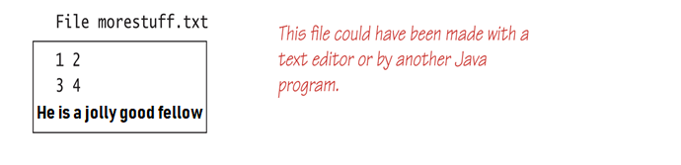
Input from a Text File Using Scanner (Part 3 of 4)
System.out.println("The three numbers read from the file are:");
System.out.println(n1 + ", " + n2 + ", and " + n3);
System.out.println("The line read from the file is:");
System.out.println(line);
inputStream.close();
}
}

Slide 33
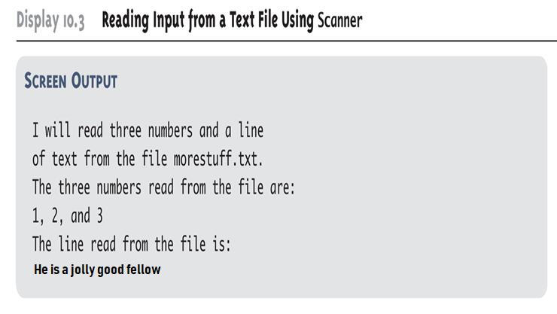
Input from a Text File Using Scanner (Part 4 of 4)

Slide 34
Testing for the End of a Text File with Scanner
A program that tries to read beyond the end of a file using methods of the Scanner class will cause an exception to be thrown
However, instead of having to rely on an exception to signal the end of a file, the Scanner class provides methods such as hasNextInt and hasNextLine
These methods can also be used to check that the next token to be input is a suitable element of the appropriate type

Slide 35
Checking for the End of a Text File with hasNextLine (Part 1 of 4)
import java.util.Scanner;
import java.io.FileInputStream;
import java.io.FileNotFoundException;
import java.io.Printwriter;
import java.io.FileOutputStream;
public class HasNextLineDemo
{
public static void main(String[] args)
{
Scanner inputStream = null;
Printwriter outputStream = null;

Slide 36
Checking for the End of a Text File with hasNextLine (Part 2 of 4)
try{
inputStream = new Scanner(new FileInputStream("original.txt"));
outputStream = new PrintWriter(new FileOutputStream("numbered.txt"));
}
catch(FileNotFoundException e){
System.out.println("Problem opening files.");
System.exit(0);
}
String line = null;
int count = 0;

Slide 37
Checking for the End of a Text File with hasNextLine (Part 3 of 4)
while (inputStream.hasNextLine()){
line = inputStream.nextLine();
count++;
outputStream.println(count + " " + line);
}
inputStream.close();
outputStream.close();
}
}

Slide 38
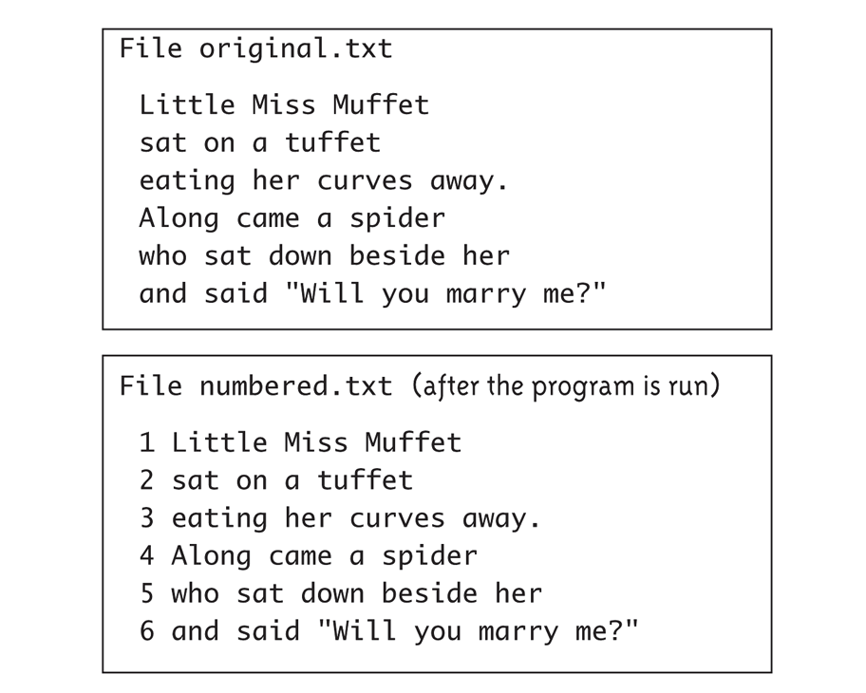
Checking for the End of a Text File with hasNextLine (Part 4 of 4)

Slide 39
Checking for the End of a Text File with hasNextInt (Part 1 of 2)
import java.util.Scanner;
import java.io.FileInputStream;
import java.io.FileNotFoundException;
public class HasNextIntDemo{
public static void main(String[] args){
Scanner inputStream = null;
try{
inputStream = new Scanner(new FileInputStream("data.txt"));
}
catch (FileNotFoundException e){
System.out.println("File data.txt was not found");
System.out.println("or could not be opened.");
System.exit(0);
}

Slide 40
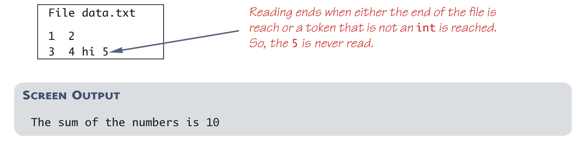
Checking for the End of a Text File with hasNextInt (Part 2 of 2)
int next, sum = 0;
while (inputStream.hasNextInt()){
next = inputStream.nextInt();
sum = sum + next;
}
inputStream.close();
System.out.println("The sum of the numbers is " + sum);
}
}

Slide 41
hasNext
The scanner also provide a more general method named hasNext that returns false if there are no more tokens of any kind in the file.
hasNext can be used when the file contains different kinds of data

Slide 42
Clone requirements
Any class willing to be cloned must
Declare the clone() method to be public
Implement Cloneable interface
class Account implements Cloneable{
public Object clone(){
try { super.clone() }
catch(CloneNotSupportedException e){ .. }
}

